Slide 1





Cybersecurity Fundamentals
Ep-2 DNS Attack Vectors
The Show
Hosted by Tony DeGonia
Cybersecurity Solutions Consultant
02
Notes:
My name is Tony DeGonia
Welcome to the second episode of Cybersecurity Fundamentals

Slide 2


Cybersecurity Fundamentals
DNS Attack Vectors
Tony DeGonia
2
Notes:
In today’s episode, we will be talking about DNS attack vectors.
Last episode we discussed DNS and how it works in a bit of detail. In this episode we will discuss the top 6 attack vectors, some of the vulnerabilities, and how attackers use those vulnerabilities to exploit a DNS server and send traffic to malicious websites where all sorts of evil maniacal things take place.
In today’s episode, all content was generated by OpenAI’s, ChatGPT.
About OpenAI
OpenAI is an AI research and deployment company. Their mission is to ensure that artificial general intelligence benefits all of humanity.

Slide 3
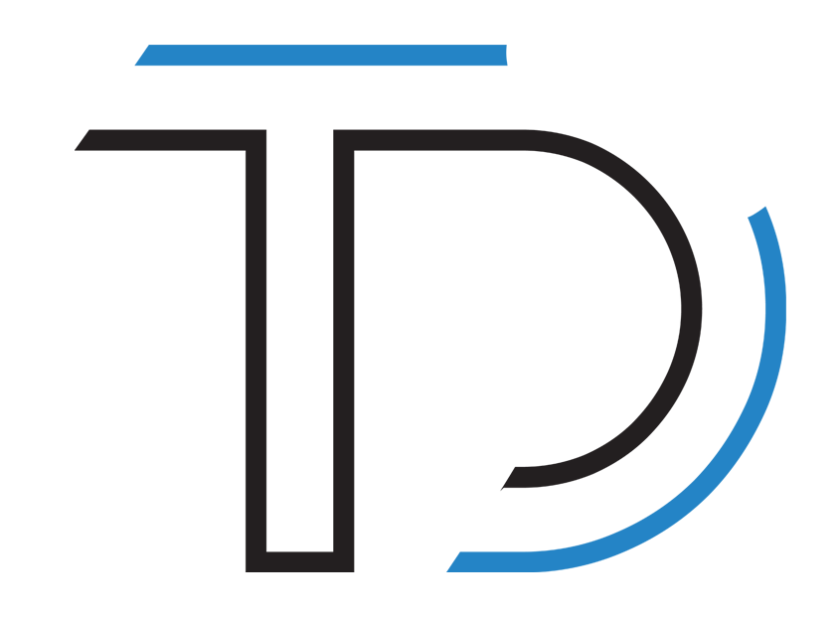
Cybersecurity Fundamentals
What are DNS Attack Vectors?
DNS spoofing or cache poisoning
Pharming
DNS amplification attacks
DDoS attacks
DNS Tunneling
DNS Hijacking
It's an attack where the attacker changes the DNS server settings on a target system or network, redirecting traffic to a malicious or compromised website.
It is a technique used to bypass security measures and exfiltrate data through the DNS protocol, this technique is commonly used by malware to communicate with its Command & Control (C&C) servers.
Distributed Denial of Service (DDoS) attacks against DNS servers can cause them to become unavailable, disrupting internet connectivity for users.
This type of attack involves the use of a large number of DNS servers to amplify the attack traffic and flood the targeted server with a large amount of traffic.
This is a type of attack where attackers redirect users to a malicious website by changing the DNS settings on their computer or router.
This occurs when an attacker alters the DNS records stored on a server or in a cache, redirecting traffic to a malicious or compromised website.
Tony DeGonia
3
Notes:
The Domain Name System (DNS) is a critical infrastructure that is used to translate domain names into IP addresses, and it plays a key role in the functioning of the internet. As such, DNS is a common target for cyber-attacks, and there are several different types of threat vectors that are commonly associated with it. The following are some of the most common:
DNS spoofing or cache poisoning: This occurs when an attacker alters the DNS records stored on a server or in a cache, redirecting traffic to a malicious or compromised website.
Pharming: This is a type of attack where attackers redirect users to a malicious website by changing the DNS settings on their computer or router.
DNS amplification attacks: This type of attack involves the use of a large number of DNS servers to amplify the attack traffic and flood the targeted server with a large amount of traffic.
DDoS attacks: Distributed Denial of Service (DDoS) attacks against DNS servers can cause them to become unavailable, disrupting internet connectivity for users.
DNS Tunneling: It is a technique used to bypass security measures and exfiltrate data through the DNS protocol, this technique is commonly used by malware to communicate with its Command & Control (C&C) servers.
DNS Hijacking: It's an attack where the attacker changes the DNS server settings on a target system or network, redirecting traffic to a malicious or compromised website.
It's important to note that these types of attacks on DNS can cause serious disruption and loss of service, and it's important to have appropriate security measures in place to protect against them.

Slide 4


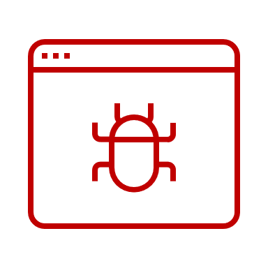


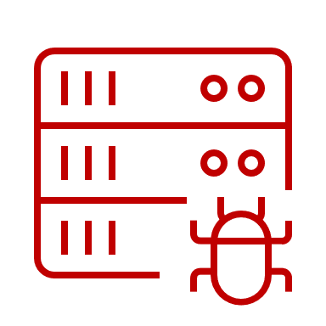
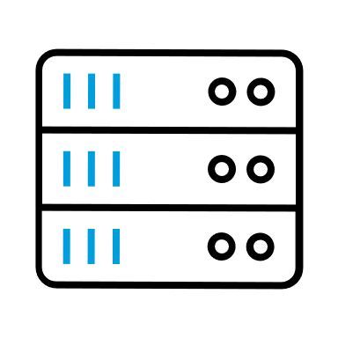
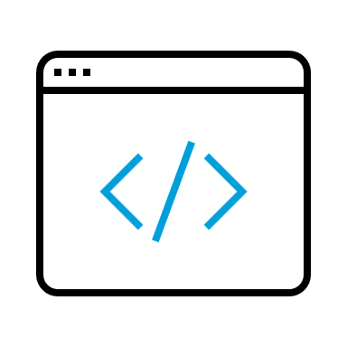




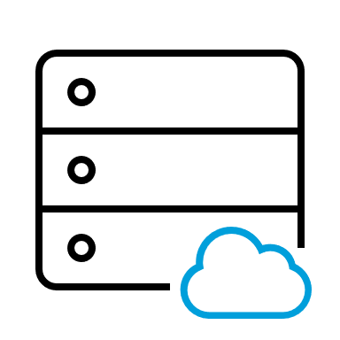

DNS Spoofing or Cache Poisoning
Cybersecurity Fundamentals
Attacker
High volume DNS requests to malicious domain
Malicious Website
Recursive DNS Server
Computer/Endpoint User
Spoofed/Poisoned DNS Server
Actual Website
Public Root DNS Server System
Tony DeGonia
4
Notes:
DNS Spoofing or Cache Poisoning
DNS spoofing, also known as cache poisoning, is a type of cyber-attack that targets the Domain Name System (DNS) infrastructure. The goal of this attack is to alter the DNS records stored on a server or in a cache, redirecting traffic from legitimate websites to malicious or compromised ones.
The attack works by taking advantage of vulnerabilities in the DNS protocol or the implementation of DNS servers. An attacker can send a large number of DNS queries to a server with forged IP addresses, tricking the server into believing that the attacker's IP address is the correct one for a given domain name. As a result, the server will store this forged information in its cache, allowing the attacker to redirect traffic from legitimate websites to malicious ones.
When a user attempts to access a legitimate website, the user's computer will first check its local DNS cache for the IP address associated with the domain name. If the cache contains the forged information, the user's computer will be directed to the attacker's IP address instead of the legitimate website, potentially exposing the user to malware or phishing attacks.
Cache poisoning can also occur if an attacker is able to gain access to the DNS server itself and alter the records stored on it.
Preventing DNS spoofing or cache poisoning requires proper configuration and maintenance of DNS servers, including implementing security measures such as DNSSEC, which is a set of extensions to DNS that provide to DNS clients origin authentication of DNS data, data integrity, and authenticated denial of existence. It also requires ensuring that software is up-to-date and monitoring for suspicious activity.
****NOTE
Is DNS spoofing the same as cache poisoning?
While the terms DNS poisoning and DNS spoofing are used interchangeably, there's a difference between the two. DNS Poisoning is the method attackers use to compromise and replace DNS data with a malicious redirect. DNS Spoofing is the end result, where users are redirected to the malicious website via a poisoned cache.

Slide 5












Pharming
Cybersecurity Fundamentals
Infected Email (Phishing)
Attacker Group
Malicious Router/Firewall
Malicious Website
Firewall
Spoofed/Poisoned DNS Server
Malware Infected Computer/Endpoint User
Recursive DNS Server
Clean Website
Computer/Endpoint User
Public Root DNS Server System
Tony DeGonia
5
Notes:
Pharming
Pharming is a type of cyber-attack that targets the Domain Name System (DNS) infrastructure. The goal of this attack is to redirect users from legitimate websites to malicious or compromised ones by changing the DNS settings on their computer or router.
Pharming attacks can be executed in several ways:
Malware: attackers can use malware to modify the DNS settings on a user's computer or router, redirecting traffic to a malicious website.
Social Engineering: attackers can trick users into visiting a malicious website and then use malware or other techniques to alter the DNS settings on their computer or router.
Hacking DNS servers: attackers can gain access to a DNS server and alter the records stored on it, redirecting traffic from legitimate websites to malicious ones.
When a user attempts to access a legitimate website, the user's computer or router will use the altered DNS settings to direct the traffic to a different IP address, potentially exposing the user to malware or phishing attacks.
Pharming attacks can cause serious disruptions and loss of service, and it's important to have appropriate security measures in place to protect against them. These measures include using anti-virus software and firewalls, keeping software and operating systems up-to-date, and being cautious when clicking on links or visiting unfamiliar websites. It's also important to monitor for suspicious activity and to be aware of phishing attempts.
Additionally, it's important to use DNS service providers that offer a secure service, such as DNSSEC (DNS Security Extensions) which provides origin authentication of DNS data, data integrity, and authenticated denial of existence.

Slide 6



A DNS amplification attack
Cybersecurity Fundamentals
The NXDOMAIN is a DNS message type received by the DNS resolver (i.e. client) when a request to resolve a domain is sent to the DNS and cannot be resolved to an IP address. An NXDOMAIN error message means that the domain does not exist.
Malicious Bot Net Controlled by Attacker
Victim Website
Command and Control Server
DNS Server
Attacker Group
DNS Server
Victim Server
DNS Server
The attacker takes control of a malicious botnet through a command-and-control server, then starts sending DNS requests to various recursive DNS servers.
DNS Server
The DNS Servers then send a response to the to the Victim Server from all the DNS Servers queried with an NXDOMAIN response.
Malicious Bot Net sends a DNS query to various DNS servers requesting resolution of a non-existent domain name with the Victim Server IP set as the source of the request.
Tony DeGonia
6
Notes:
A DNS amplification attack
A DNS amplification attack is a type of Distributed Denial of Service (DDoS) attack that uses the Domain Name System (DNS) infrastructure to amplify the attack traffic and flood the targeted server with a large amount of traffic. This type of attack is also known as a "DNS flood" or "DNS amplification DDoS".
The attack works by exploiting the fact that DNS servers are typically configured to respond to requests from any IP address. An attacker can use a large number of compromised or maliciously controlled DNS servers to send a large number of DNS queries, with the target server's IP address as the "source" address, to other DNS servers on the internet. The responses to these queries, which can be much larger than the original queries, will be directed back to the target server, overwhelming it with traffic and making it unavailable for legitimate users.
One of the most common types of DNS amplification attacks is the "NXDOMAIN" attack, which relies on the fact that DNS servers will respond with a large "NXDOMAIN" packet when a query is made for a non-existent domain. The attacker can use a list of non-existent domain names and the IP address of the target server as the source address to send a large number of queries to DNS servers, which will respond with large NXDOMAIN packets directed to the target server.
DNS amplification attacks can be mitigated by proper configuration and maintenance of DNS servers, including rate limiting, filtering traffic, monitoring, and logging, and using specialized DDoS protection services. It's also important to ensure that DNS servers are not being used as open resolvers, which can be easily misused by attackers.

Slide 7

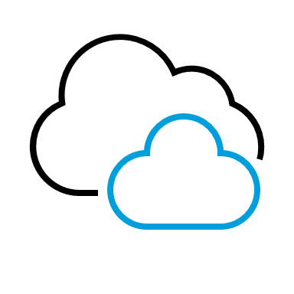
DDoS Attack
Application-layer attacks: These attacks target the application layer of a targeted website or service, such as HTTP floods, which can overwhelm the targeted website's resources or exhaust its connection pool.
Cybersecurity Fundamentals
Malicious Bot Net Controlled by Attacker
Protocol Attack
Firewall
Application Server
Command and Control Server
Attacker Group
Malicious Traffic
Volumetric Attack
Firewall
Corporate Network
Application-Layer Attack
Web Application Firewall
Web Server
Volumetric Attack: These attacks flood the targeted website or service with a large amount of traffic, such as UDP floods, ICMP floods, and other types of packet floods.
Protocol attacks: These attacks exploit vulnerabilities in the targeted website or service's infrastructure, such as SYN floods, Ping of Death, and other types of protocol attacks.
Tony DeGonia
7
Notes:
DDoS Attacks
A Distributed Denial of Service (DDoS) attack is a type of cyber-attack that aims to make a website or online service unavailable by overwhelming it with a large amount of traffic from multiple sources. The goal of a DDoS attack is to disrupt normal traffic to a website or service, making it unavailable to legitimate users.
DDoS attacks typically involve a network of compromised or maliciously controlled computers and devices (referred to as "bots" or "zombies") that are used to flood a targeted website or service with a large amount of traffic. The traffic can come from multiple sources, making it difficult to block or filter. This flood of traffic can cause the targeted website or service to become overwhelmed and unable to respond to legitimate requests, resulting in a denial of service.
There are several types of DDoS attacks, including:
Volume-based attacks: These attacks flood the targeted website or service with a large amount of traffic, such as UDP floods, ICMP floods, and other types of packet floods.
Protocol attacks: These attacks exploit vulnerabilities in the targeted website or service's infrastructure, such as SYN floods, Ping of Death, and other types of protocol attacks.
Application-layer attacks: These attacks target the application layer of a targeted website or service, such as HTTP floods, which can overwhelm the targeted website's resources or exhaust its connection pool.
DDoS attacks can cause serious disruptions and loss of service, and it's important to have appropriate security measures in place to protect against them. These measures include using firewalls, intrusion detection and prevention systems, load balancers, and specialized DDoS protection services. It's also important to have a DDoS incident response plan in place and to be prepared to work with law enforcement and other organizations to mitigate the attack.

Slide 8
DNS Tunneling
Cybersecurity Fundamentals
DNS Tunneling is often a very successful attack vector because many corporate networks do not monitor or scan port 53 which is used for DNS transactions.
Corporate Network
Clean Destination Website
Infected Host
Attacker Group
Command and Control Server
DNS Tunnel – Port 53
DNS Tunnel – Port 53
Recursive DNS Server
Clean Internet Traffic
Firewall
Public Root DNS Server System
Corporate Network
Tony DeGonia
8
Notes:
DNS Tunneling
DNS Tunneling is a technique used to bypass security measures and exfiltrate data through the Domain Name System (DNS) protocol. It is a method of using the DNS protocol to establish a connection between a client and a server and then send data over that connection. The data is encoded and hidden within DNS queries and responses, making it difficult to detect and block
.
DNS Tunneling is commonly used by malware to communicate with its Command and Control (C&C) servers. This type of malware will typically establish a connection to a domain name that is controlled by the attacker and then use DNS queries and responses to send data back and forth between the malware on the infected device and the C&C server.
DNS Tunneling can also be used for other malicious purposes, such as exfiltrating sensitive data from a network, bypassing firewalls, and evading detection by security software.
Preventing DNS Tunneling requires a multi-layered approach that includes monitoring and analyzing network traffic for suspicious DNS activity, implementing security measures such as firewalls and intrusion detection systems, and using specialized software to detect and block DNS Tunneling. Additionally, using DNSSEC (DNS Security Extensions) which provides origin authentication of DNS data, data integrity, and authenticated denial of existence can help to prevent malicious changes to the DNS records.
It's also important to be aware of the indicators of DNS Tunneling, such as large numbers of DNS queries to a single domain, or unusual patterns of DNS traffic, and to investigate any suspicious activity that is detected.

Slide 9
DNS Hijacking
Cybersecurity Fundamentals
Attacker Group
Corporate Network
Malware Infected Host
Malicious Destination Website
Clean Destination Website
Hacked Recursive DNS Server
Compromised Router or Firewall
Corporate Mail Server
Public Root DNS Server System
Corporate Network
Infected Email (Phishing)
Tony DeGonia
9
Notes:
DNS Hijacking
DNS hijacking, also known as DNS redirection, is a type of cyber-attack that alters the Domain Name System (DNS) settings on a target system or network, redirecting traffic from legitimate websites to malicious or compromised ones.
DNS hijacking can occur in several ways, including:
Compromised routers: An attacker can gain access to a router and alter its DNS settings, redirecting traffic to a malicious website.
Malware: An attacker can use malware to modify the DNS settings on a user's computer, redirecting traffic to a malicious website.
Phishing: An attacker can trick users into visiting a malicious website and then use malware or other techniques to alter the DNS settings on their computer or router.
Hacking DNS servers: An attacker can gain access to a DNS server and alter the records stored on it, redirecting traffic from legitimate websites to malicious ones.
When a user attempts to access a legitimate website, the user's computer or router will use the altered DNS settings to direct the traffic to a different IP address, potentially exposing the user to malware or phishing attacks.
Preventing DNS hijacking requires proper configuration and maintenance of routers and DNS servers, including using strong passwords, keeping software up-to-date, and monitoring for suspicious activity.
It's also important to use DNS service providers that offer a secure service, such as DNSSEC (DNS Security Extensions) which provides origin authentication of DNS data, data integrity, and authenticated denial of existence. It is also important to be aware of the indicators of DNS hijacking, such as changes in DNS settings or redirects to unexpected websites, and to investigate any suspicious activity that is detected.

Slide 10




Cybersecurity Fundamentals
Thank you for watching
Check out the next episode of Cybersecurity Fundamentals on:
@TheTonyDeGoniaShow @tonydegonia @tonydegonia
Tony DeGonia
Notes:
Thank you for watching
Check out the next episode of Cybersecurity Fundamentals on:
YouTube – https://www.youtube.com/tonyd_thecyberguru
LinkedIn – https://www.linkedin.com/in/tonydegonia
Twitter – https://www.twitter.com/tonydegonia

