Slide 1





Cybersecurity Fundamentals
DNS Basics
The Show
Hosted by Tony DeGonia
Cybersecurity Solutions Consultant
02
Notes:
This is Episode 1 of Cybersecurity Fundamentals.
Cybersecurity Fundamentals is a series of short 5 – 15 minute videos designed to give the viewer a quick understanding of the technologies, best practices, threats, and defensive techniques that are prevalent, and affect users on the internet and in corporate networks around the world. We design these informational videos with everyday users of computing technologies in mind. In today’s episode, we will be covering DNS Basics.
Please enjoy the video and we hope that you will walk away from this video with a better understanding of DNS.

Slide 2

Cybersecurity Fundamentals
DNS Basics
Tony DeGonia
2

Slide 3

Cybersecurity Fundamentals
What is DNS?
The domain name system (DNS) is:
a naming database in which internet domain names are located and translated into Internet Protocol (IP) addresses.
The domain name system maps the name people use to locate a website to the IP address that a computer uses to locate that website.
Tony DeGonia
3
Notes:
The domain name system (DNS) is:
a naming database in which internet domain names are located and translated into Internet Protocol (IP) addresses.
The domain name system maps the name people use to locate a website to the IP address that a computer uses to locate that website.

Slide 4
Cybersecurity Fundamentals
What are the three main benefits of DNS?
The benefits of DNS are that domain names:
Maps to a new IP address if the host's IP address changes.
Are easier to remember than an IP address.
Allows organizations to use a domain name hierarchy that is independent of any IP address assignment.
Tony DeGonia
4
Notes:
The benefits of DNS are that domain names:
Maps to a new IP address if the host's IP address changes.
They are easier to remember than an IP address.
Allows organizations to use a domain name hierarchy that is independent of any IP address assignment.

Slide 5
Cybersecurity Fundamentals
What are DNS Servers?
How many types of DNS Servers are there and what are they called?
Recursive (Resolver) Nameserver
Authoritative Nameserver
Root Nameserver
TLD Nameserver
Tony DeGonia
5
Notes:
How many types of DNS Servers are there and what are they called?
RECURSIVE RESOLVER
A recursive resolver (also known as a DNS recursor) is the first stop in a DNS query
The recursive resolver acts as a middleman between a query from a web client.
A recursive resolver will either respond with cached data, or send a request to a root nameserver, followed by another request to a TLD nameserver, and then one last request to an authoritative nameserver.
After receiving a response from the authoritative nameserver containing the requested IP address, the recursive resolver then sends a response to the client.
DNS ROOT NAMESERVER
The 13 DNS root nameservers are known to every recursive resolver, and they are the first stop in a recursive resolver’s quest for DNS records.
A root server accepts a recursive resolver’s query which includes a domain name, and the root nameserver responds by directing the recursive resolver to a TLD nameserver, based on the extension of that domain (.com, .net, .org, etc.).
The root nameservers are overseen by a nonprofit called the Internet Corporation for Assigned Names and Numbers (ICANN).
TLD NAMESERVER
A TLD nameserver maintains information for all the domain names that share a common domain extension, such as .com, .net, or whatever comes after the last dot in a URL.
For example, a .com TLD nameserver contains information for every website that ends in ‘.com’.
If a user was searching for google.com, after receiving a response from a root nameserver, the recursive resolver would then send a query to a .com TLD nameserver, which would respond by pointing to the authoritative nameserver for that domain.
AUTHORITATIVE NAMESERVER
When a recursive resolver receives a response from a TLD nameserver, that response will direct the resolver to an authoritative nameserver.
The authoritative nameserver is usually the resolver’s last step in the journey for an IP address.
The authoritative nameserver contains information specific to the domain name it serves (e.g. tonydegonia.com) and it can provide a recursive resolver with the IP address of that server found in the DNS A record, or if the domain has a CNAME record (alias) it will provide the recursive resolver with an alias domain.
At this point, the recursive resolver will have to perform a whole new DNS lookup to procure a record from an authoritative nameserver (often an A record containing an IP address).

Slide 6
Cybersecurity Fundamentals
What are DNS records and what do they do?
Here are some of the most common records:
A Record (Address Mapping record)
MX (Mail Exchange record)
TXT (Text Record)
AAAA (IP version 6 Address record)
CNAME (Canonical Name record)
Tony DeGonia
6
Notes:
Here are some of the most common records:
A Record (Address Mapping record) This is the address record. Most commonly used for linking hostnames (e.g., domains) with corresponding IPv4 addresses.
AAAA (IP version 6 Address record) This is also an address record, but for IPv6 addresses. Its function is the same as an A Record.
CNAME (Canonical Name record) CNAME aliases one hostname to another. What does it mean? It works similarly to an A Record, but instead of linking to an IP address, it links to another hostname.
MX (Mail Exchange record) MX records are used to route outgoing emails to an email server. They specify an SMTP email server for a domain.
TXT (Text Record) These are machine-readable data that you add to your DNS. They may have various purposes, one of which is email security (the SPF, DKIM, and DMARC records).

Slide 7


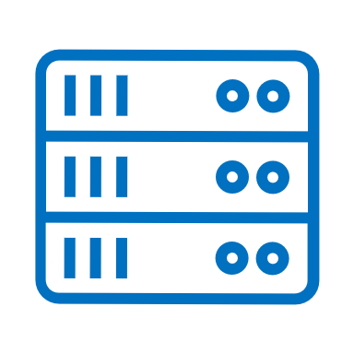



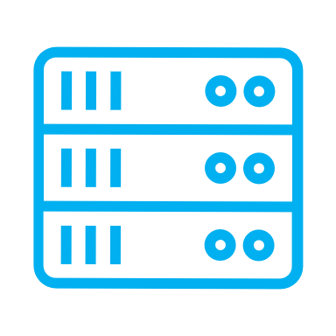


Cybersecurity Fundamentals
What is DNS?
The basic process of DNS resolution follows these steps:
Recursive DNS query
Recursive DNS Server
Query secondary/tertiary DNS Servers
Three DNS Server Types
This site can’t be reached.
root name servers
top-level domain (TLD) name servers
authoritative name servers
Caches the A record and domain IP Address
Returns an error message that site cannot be located.
Secondary DNS Server
https://www.tonydegonia.com
Primary
Web page is found and opens
If DN is stored in cache on recursive server
Query to return tonydegonia.com
Returns the webpage for https://www.tonydegonia.com.
Tony DeGonia
7
Notes:
The user enters a web address or domain name into a browser.
The browser sends a message, called a recursive DNS query, to the network to find out which IP or network address the domain corresponds to.
The query goes to a recursive DNS server, which is also called a recursive resolver and is usually managed by the internet service provider (ISP). If the recursive resolver has the address, it will return the address to the user, and the webpage will load.
If the recursive DNS server does not have an answer, it will query a series of other servers in the following order: DNS root name servers, top-level domain (TLD) name servers, and authoritative name servers.
The three server types work together and continue redirecting until they retrieve a DNS record that contains the queried IP address. It sends this information to the recursive DNS server, and the webpage the user is looking for loads. DNS root name servers and TLD servers primarily redirect queries and rarely provide the resolution themselves.
The recursive server stores, or caches, the A record for the domain name, which contains the IP address. The next time it receives a request for that domain name, it can respond directly to the user instead of querying other servers.
If the query reaches the authoritative server and it cannot find the information, it returns an error message.
The entire process of querying the various servers takes a fraction of a second and is usually imperceptible to the user.

Slide 8

Cybersecurity Fundamentals
Thank you for watching
Check out the next episode of Cybersecurity Fundamentals on:
                YouTube – https://www.youtube.com/tonyd_thecyberguru
                LinkedIn – https://www.linkedin.com/in/tonydegonia
                Twitter – https://www.twitter.com/tonydegonia
Tony DeGonia

